Slide 1


“Sustainability Shines in our Seven Schools”
2022

Slide 2

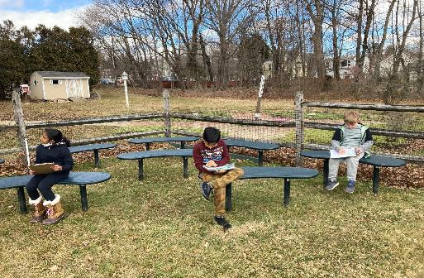
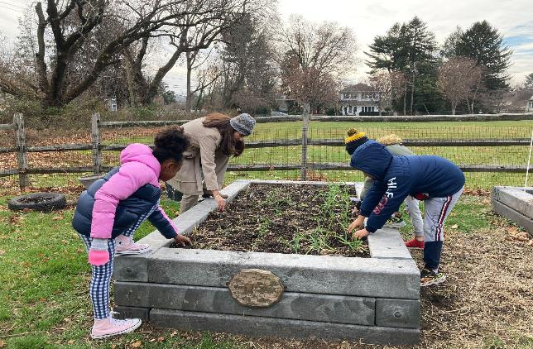
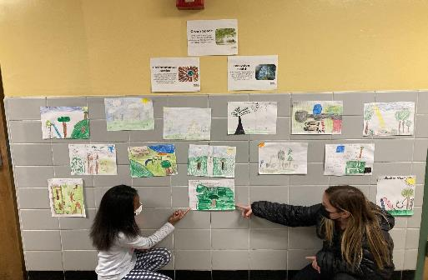
Outdoor Classroom: Mindfulness Practices
Climate
Change
‘Greenspace’
‘Plant to Plate’ at LES!

Slide 3
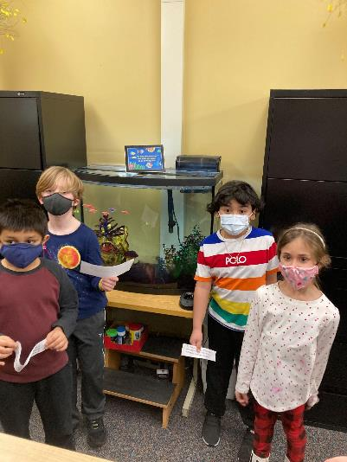
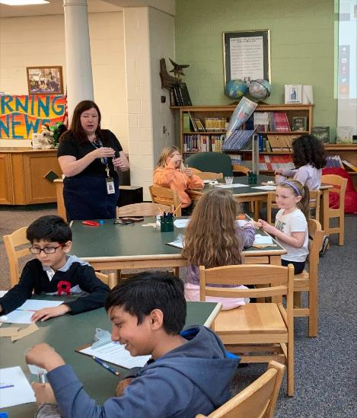
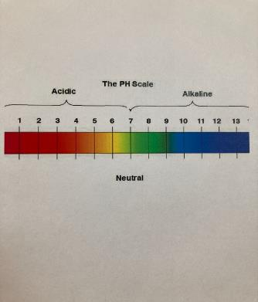
LES takes care of our Animal Environments!
Mrs. Oliver Teaches about
Water Pollution

Slide 4
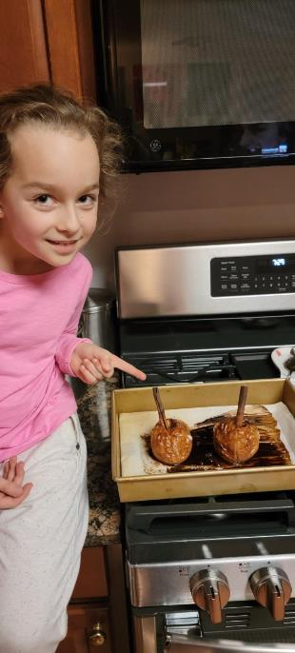
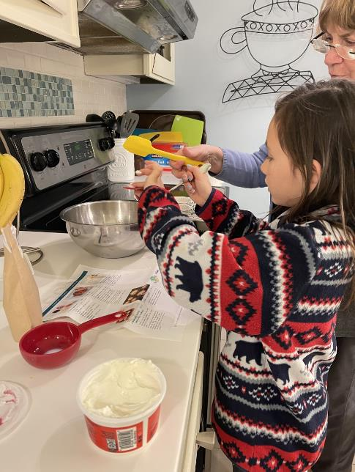
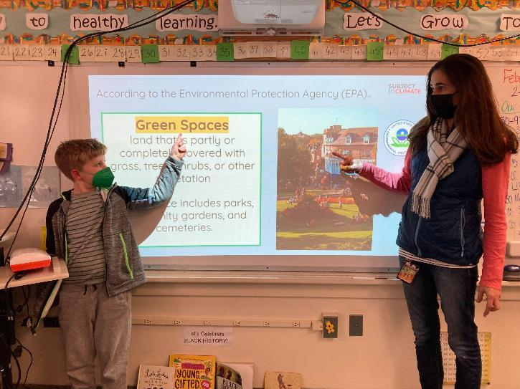
Making Culinary Connections to Reading with our Families.
Learning about GREENspaces!

Slide 5
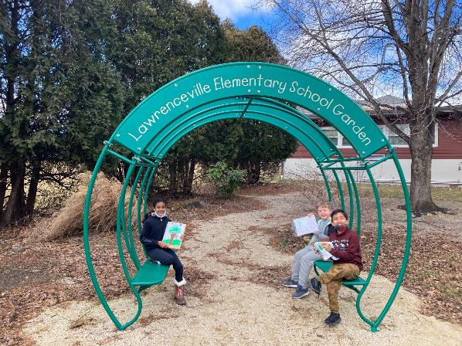
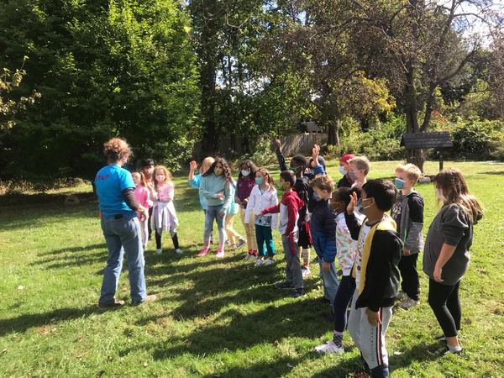
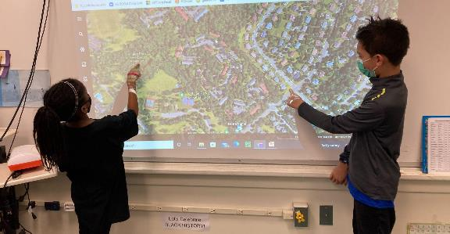
Celebrating our Climate.
Google Earth and our Environment.
Working with Farmer Mel and Composting.

Slide 6

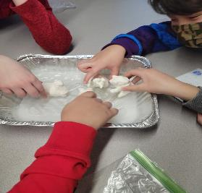
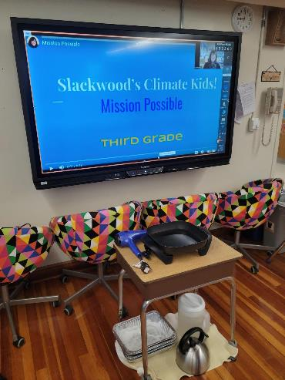
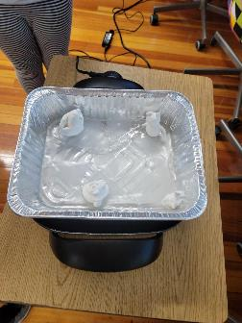
Students built polar bears and added them to the sea ice. We changed the conditions of the 'sea ice' by heating up the water, adding water, and heating up air with hair dryer... lots of questions and great thinking from the students!

Slide 7
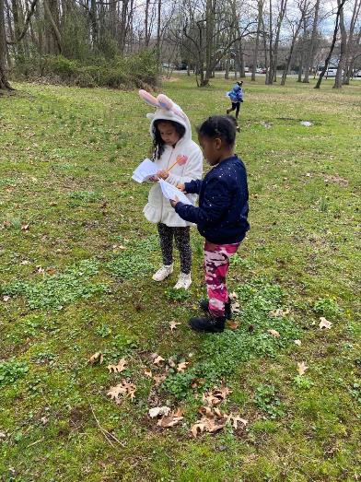
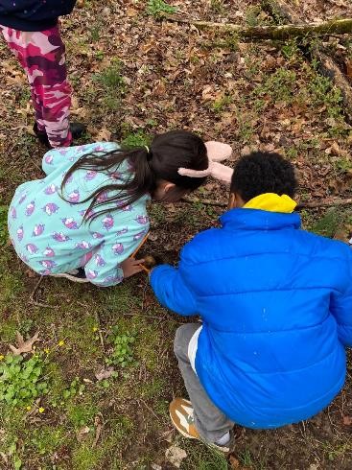
First graders participated in activities for our Climate Kids program on April 1st. They learned an Earth Day song, did a nature scavenger hunt, and made observations about natural elements that could be found on school grounds.

Slide 8
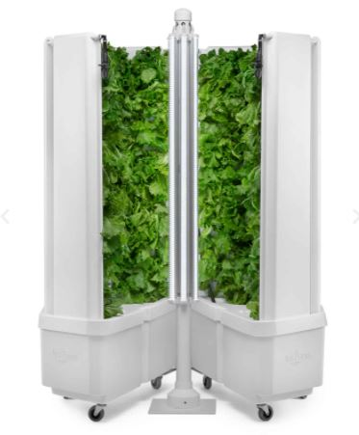
The Lawrence Township Education Foundation awarded Slackwood a grant to purchase a Flex Farm hydroponic growing system. Students and staff will work together to grow fresh produce right inside our school!

Slide 9

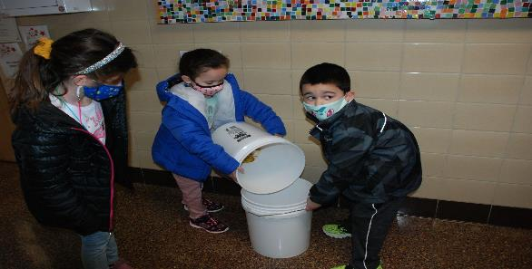
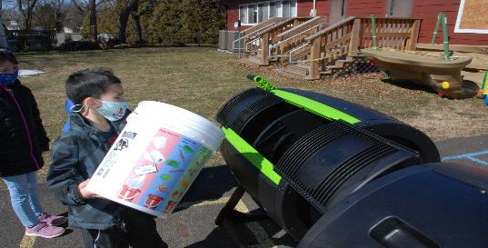
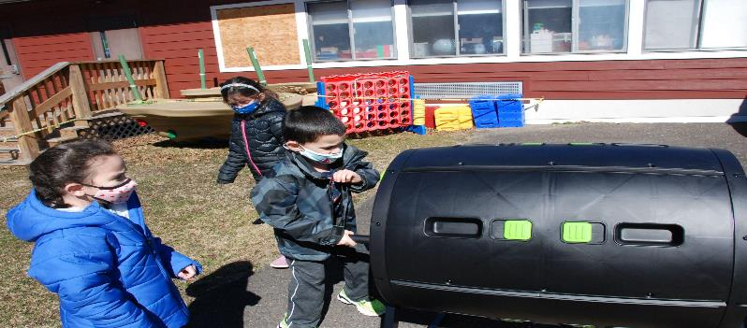
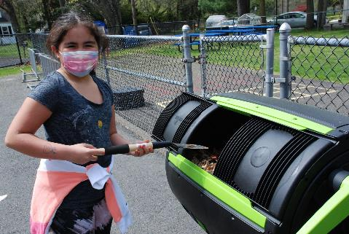
AT EPS WE ARE COMPOSTERS!
Our EPS students compost daily and deliver the materials to our compost buckets.

Slide 10

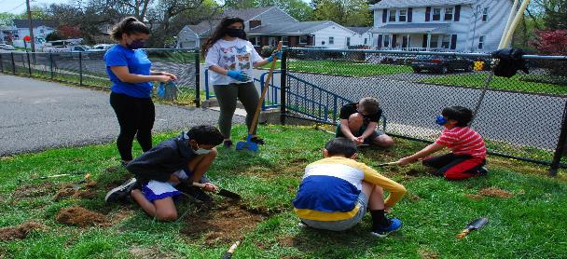
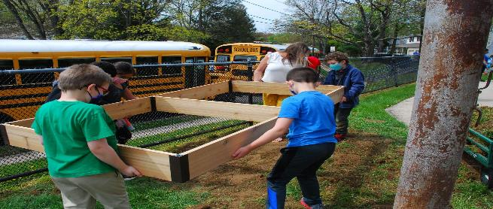
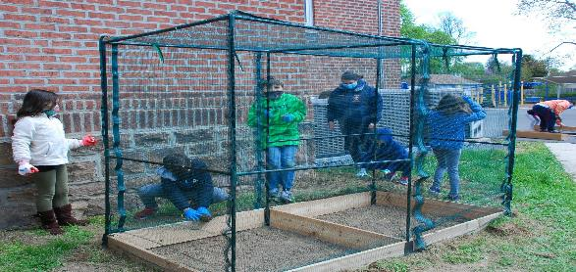
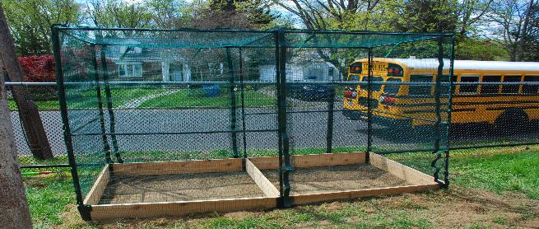
WE ARE GARDENERS!
At EPS we built our own gardens from the ground up! This year we will be planting and harvesting!

Slide 11
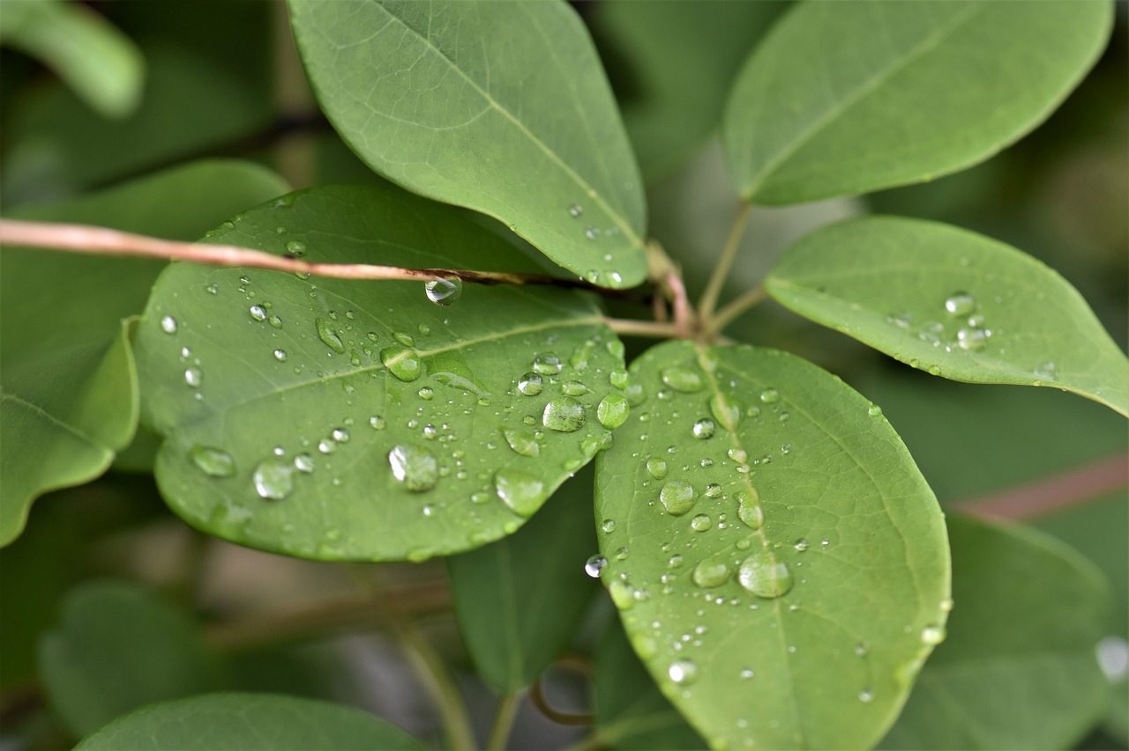
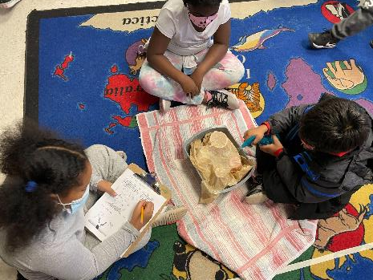

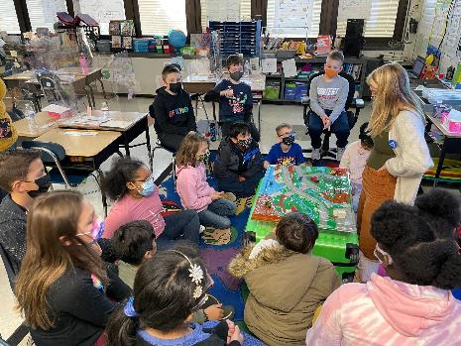
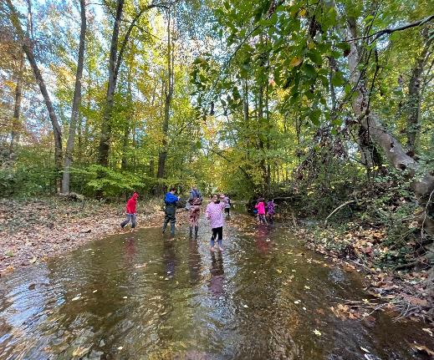
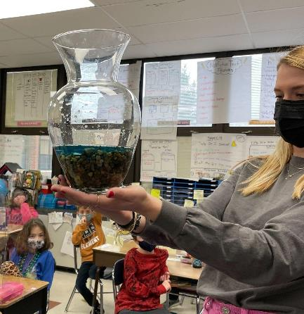
Our 3rd graders engage in being school Streamkeepers to participate in hands-on activities involving the nearby stream. Students make observations, predictions, and hold discussions about how the stream can be kept protected. NJ Watershed Ambassadors have partnered with our class to inform us about the importance of aquifers and how watersheds function. When it’s warm enough, students adventure in “stream stomps” to collect data, make observations, and help keep the stream clean!

Slide 12

Lawrence Intermediate School

Slide 13
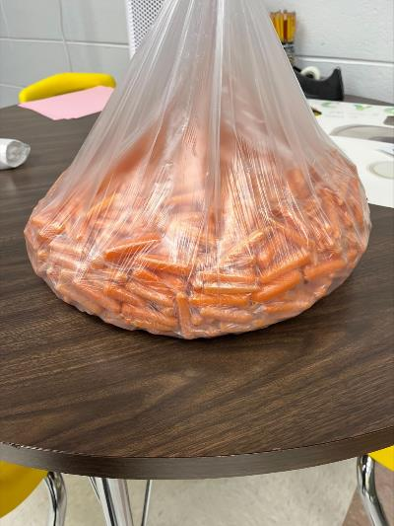
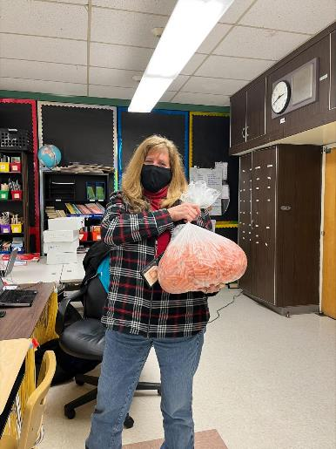
Amount of carrots recycled to a farm from one day!

Slide 14
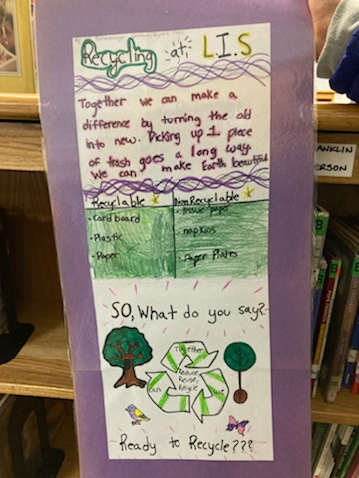
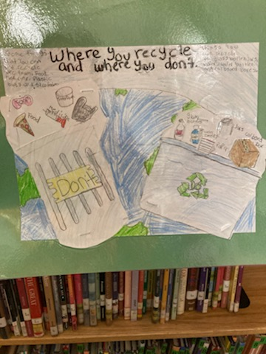
LIS Green Team Poster Contest

Slide 15
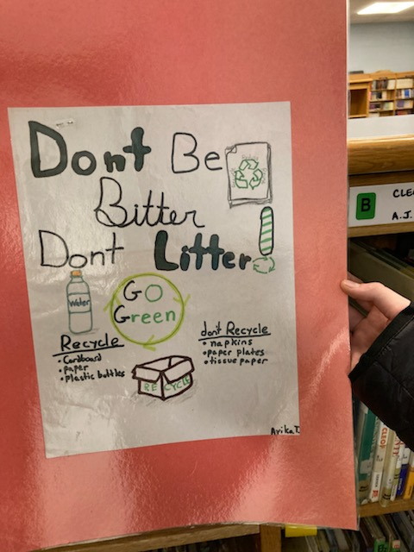
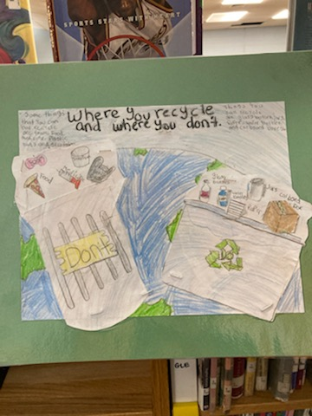

Slide 16
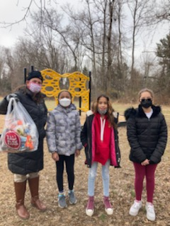
Green Team Play Ground Cleanup

Slide 17
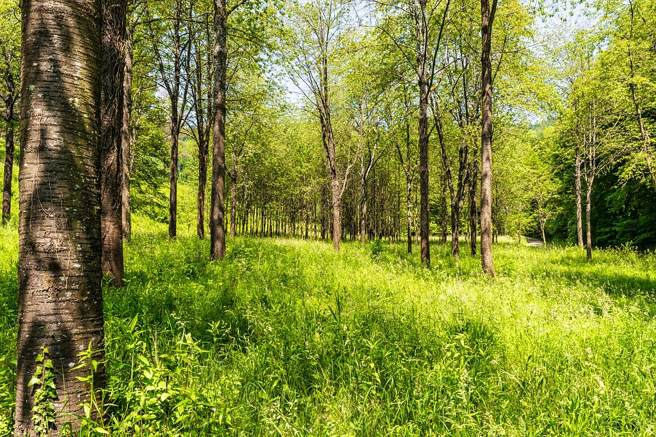

Environmental Clean up
By: Ellie Hauger (Green Team Member) 1/31/22 Ms.Neirotti/Ms.Heller
Enrichment

Slide 18
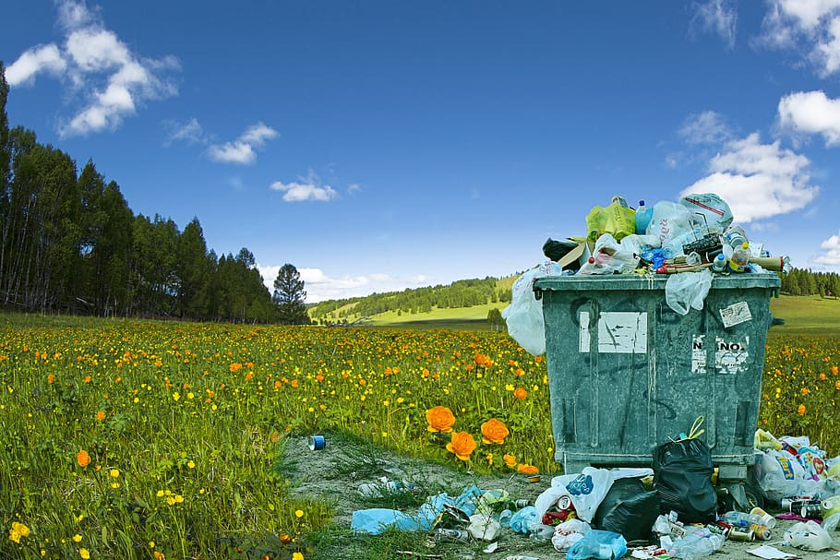
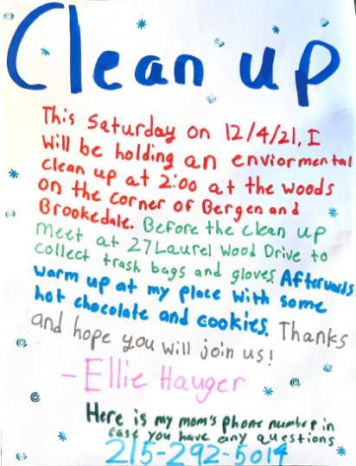

LIS Sustainable Efforts
Families were invited to go and clean up my neighborhood woods.
3 families including myself actually did the clean up .

Slide 19
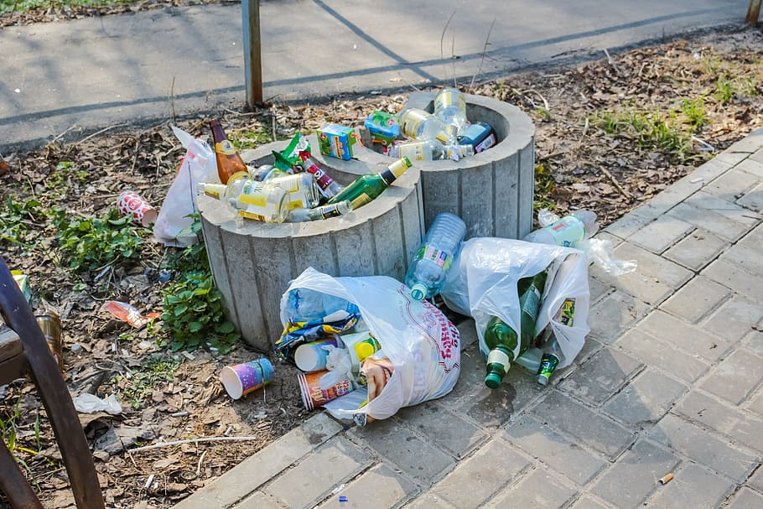

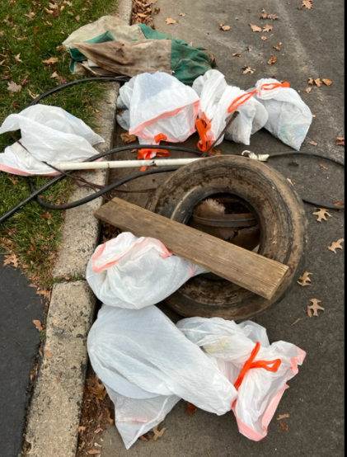
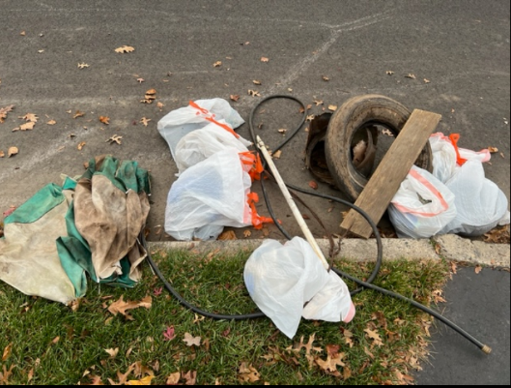
How Much Garbage
We collected 6 bags of beer bottles, a tin bucket,and broken glass
We also collected a tire, a wire, a hose, a wooden plank, and a broken umbrella

Slide 20

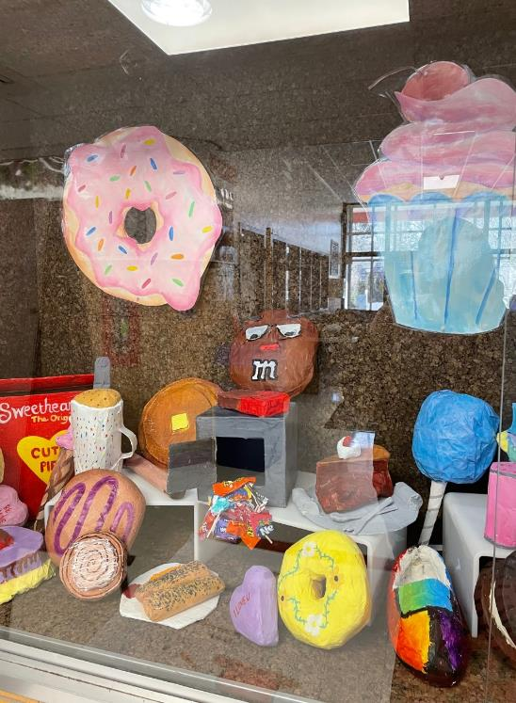
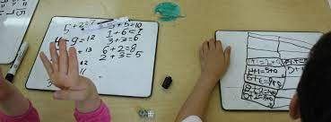
Paper mache artworks in the front display case were created from recycled newspaper.
Math classes use whiteboards instead of scrap paper when doing online assignments.
Ms. Macaroni’s class we used pictures from old calendars. All pictures were of dogs. Students had to use their descriptive skills to help us visualize their dog before sharing their image with the class.

Slide 21

ECP 8 did UN Global Goals projects on environmental issues.
Click HERE for the assignment
Previously, we explored what we perceive to be the greatest challenges faced globally.
What are the greatest problems faced by our world? (Though each response may not apply to every part of the world, think globally to create your list.) | What is this issue a problem? Briefly identify the negative impact of the problem you identified. | What do you think are the first steps necessary to solving the problem? Whom do you think must take these first steps?

Slide 22

Recently in a near-unanimous decision, the leaders of the UN come to an agreement to only sustain one source of energy production worldwide. Elected to the council, you and 16 other members of the group must decide on The One Energy To Rule Them All. (Lord of the Rings reference!)
After a quick round-table discussion, you list down all the methods to generate electricity, and after some narrowing down, you end up with:
Coal
Natural Gas
Nuclear Energy
Renewables
As chairperson of the group, you must state your opinion. Though you do not have absolute power over the discussion, your choice will heavily influence the decisions of the other committee members.
Go to page 4 for “Coal.”
Go to page 5 for “Natural Gas.”
Go to page 7 for “Nuclear Energy.”
Go to page 12 for “Renewables.”
ECP 8 did UN Global Goals projects on environmental issues.
You are the Chairperson in the UN’s energy committee.
Click HERE for the script

Slide 23
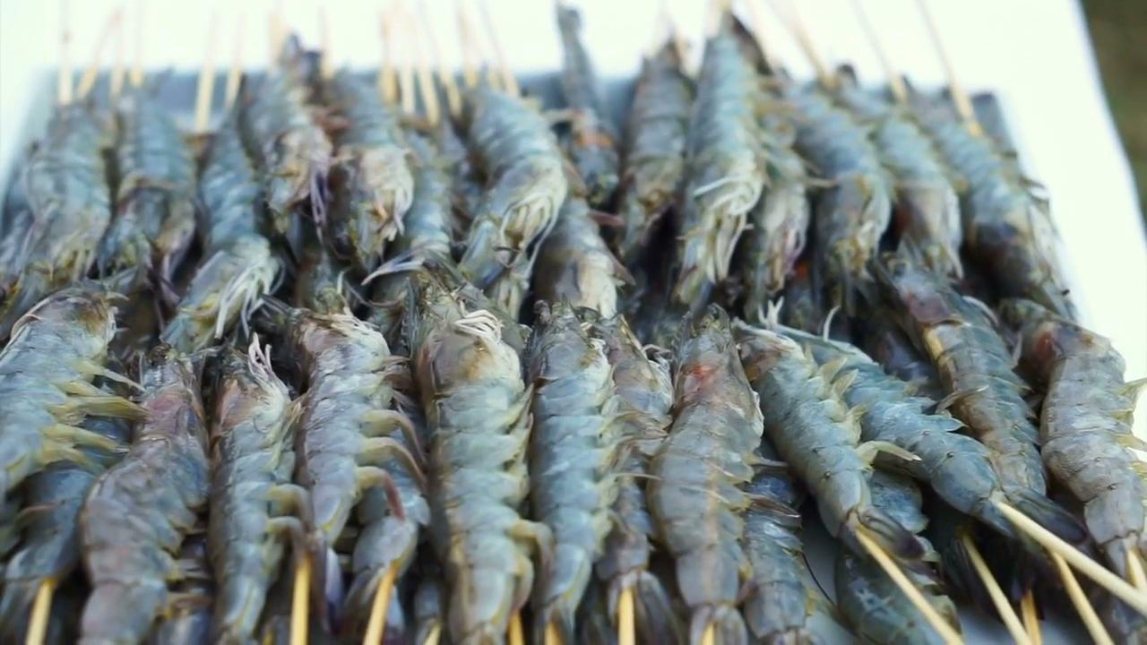
ECP 8 did UN Global Goals projects on environmental issues.
Life Below Water
Conserve and sustainably use oceans, seas, and marine resources for sustainable development.

Slide 24
What aspects of the heroes’ backgrounds was interesting/ surprising?
What aspects of the heroes’ backgrounds was not at all surprising?
What do the heroes have in common? (Many, if not all)
Which hero is the most accomplished, in your opinion? Why?
Which hero doesn’t “make sense” to you? Why?
Sustainable Jersey Heroes
Before beginning the writing for today, complete the table.
Click HERE for the assignment

Slide 25
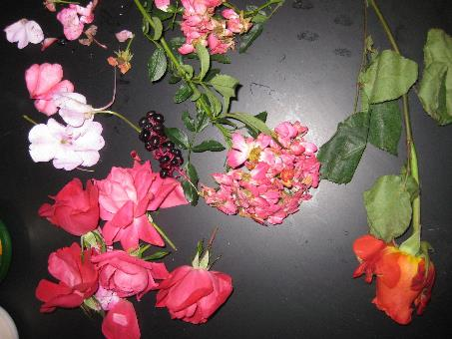
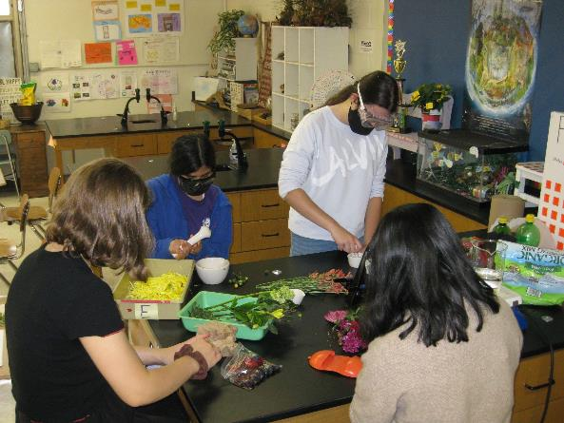
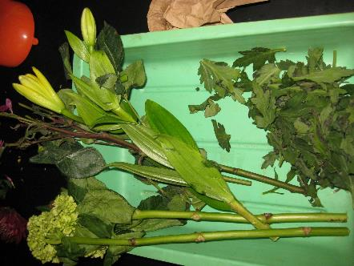
Lawrence High School
Nature’s Watercolor Lab: Using flower petals, soil, and plant leaves to make pigments, then creating original paintings

Slide 26



Lawrence High School
Nature’s Watercolor Lab: Works in Progress!

Slide 27


Lawrence High School
Nature’s Watercolor Lab: The Finished Paintings!

Slide 28



Lawrence High School
Harvesting from our Perennial Herbal Courtyard Garden: spearmint, peppermint, rosemary, dill, sage, and lavender AND lettuce from our very own Aerogarden!

Slide 29




Lawrence High School
Winter Workshop: Creating Handmade Bird feeders!

Slide 30


Lawrence High School
Weekend Activity: Park Clean Up and Trail Walk

Slide 31




Lawrence High School
Weekend Activity: Park Clean Up and Trail Walk

Slide 32


Lawrence High School
Weekend Activity: Park Clean Up and Trail Walk
Potty Break!

Slide 33
Cari Gallagher
LTPS District Green Team Leader
cgallagher@ltps.org

